Slide 1

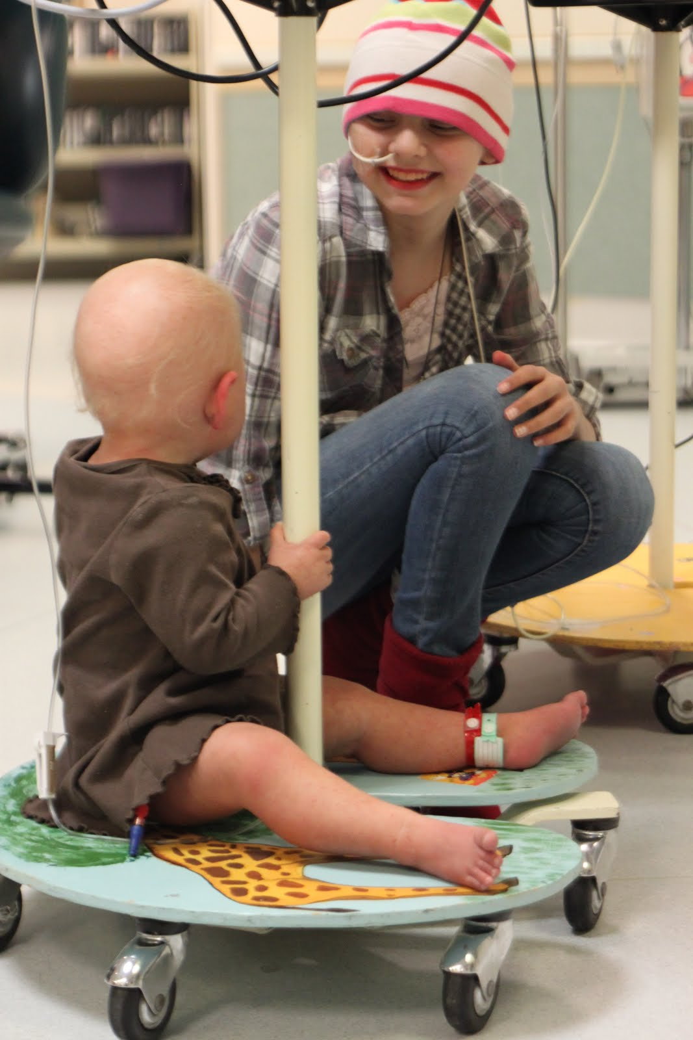
Drug Therapy in Pediatric Patients

Slide 2
Drug Therapy in Pediatric Patients
Inadequate research data currently exists for prescribers to ensure safe dosing for infants/children.
→Two thirds of drugs used in pediatrics have never been tested in pediatric patients
20 % of drugs were ineffective for children (even though they were effective for adults)
30 % of drugs caused unanticipated side effects, some of which were potentially lethal
20 % of drugs required dosages different from those that had been extrapolated from dosages used in adults

Slide 3
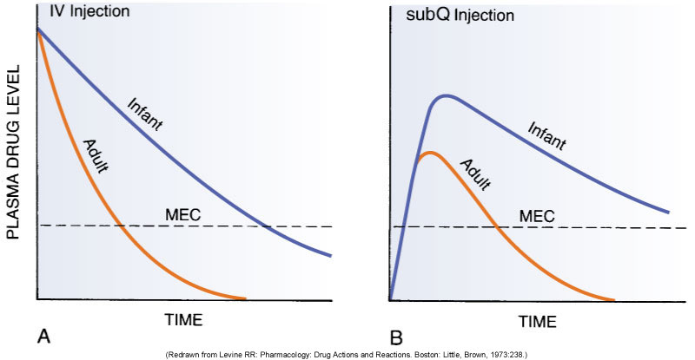
Drug Therapy in Pediatric Patients
Pharmacokinetics: Comparison between Infants and Adults
Figure 10-1: Drug doses adjusted to body weight were administered to infants and adults, via IV injection (left) or subcut (right). Duration/time above MEC, and peak drug levels, differed significantly between infants and adults. Therefore, adjusting dose amounts based on body size alone is inadequate to safely medicate neonates and infants.

Slide 4
Drug Therapy in Pediatric Patients: Clearly, children are not little adults
In what specific physiologic ways are neonates/infants and children different from adults?
How do these differences influence pharmacokinetics and drug therapy in pediatric age groups?
When do the differences in neonates/infants and children become physiologically comparable to the adult?

Slide 5
Drug Therapy in Pediatric Patients
Neonates/infants are more sensitive to drugs than adults
due mainly to organ system immaturity
Neonates/infants are at increased risk for adverse drug reactions
Young patients show greater individual variation

Slide 6
Drug Therapy in Pediatric Patients: Stages & Definitions
“Pediatrics” broadly encompasses all patients younger than age 16 years. Many organs and functions are immature at birth. Different age groups have unique therapeutic challenges and considerations.
Premature infants
Less than 36 weeks’ gestational age
Full-term infants
36 to 40 weeks’ gestational age
Neonates
First 4 postnatal weeks
Infants
Weeks 5 to 52 postnatal
Children
1 to 12 years old
Adolescents
12 to 16 years old
Notes:
6

Slide 7
Pediatric and Neonatal Pharmacokinetics
One size doesn’t fit all
Preterm neonates (<36 weeks’ gestation)
Full-term neonates (birth to 30 days)
Infants (1–12 months)
Toddlers (1–4 years)
Children (5–12 years)
Adolescents (>12 years)

Slide 8
Drug Therapy in Pediatric Patients: Pharmacokinetics in Neonates and Infants
Neonates and infants have immature organs, regulatory systems and other differences from mature adults.
affect pharmacokinetic processes
neonates/infants are more sensitive to medications than adults

Slide 9
Pharmacokinetics in Neonates and Infants: ABSORPTION
● Absorption
Oral administration
Gastric emptying time
Prolonged and irregular
Adult function at 6 to 8 months
Gastric acidity
Very low 24 hours after birth
Does not reach adult values until age 2 years
Low acidity: Absorption of acid-labile drugs is increased
Intramuscular administration
During the first few days of life: Slow, Erratic, Delayed absorption as a result of low blood flow
During early infancy, absorption of intramuscular drugs more rapid than in neonates and adults
Transdermal absorption
Stratum corneum of infant’s skin is very thin
Blood flow to skin greater in infants than in older patients
More rapid and complete for infants than for older children and adults
Infants at increased risk of toxicity from topical drugs
Notes:
9

Slide 10
Pharmacokinetics in Neonates and Infants: DISTRIBUTION
● Distribution
Protein binding
Binding of drugs to albumin and other plasma proteins is limited in the infant
Amount of serum albumin is relatively low
Consequence? _______________
Blood-brain barrier
Not fully developed at birth
Drugs and other chemicals have relatively easy access to the CNS
Infants especially sensitive to drugs that affect CNS function
Dosage should also be reduced for drugs used for actions outside the CNS if those drugs are capable of producing CNS toxicity as a side effect
Endogenous compounds compete with drugs for available binding sites
Limited drug/protein binding in infants
Reduced dosage needed
Adult protein binding capacity by 10 to 12 months of age
Notes:
10

Slide 11
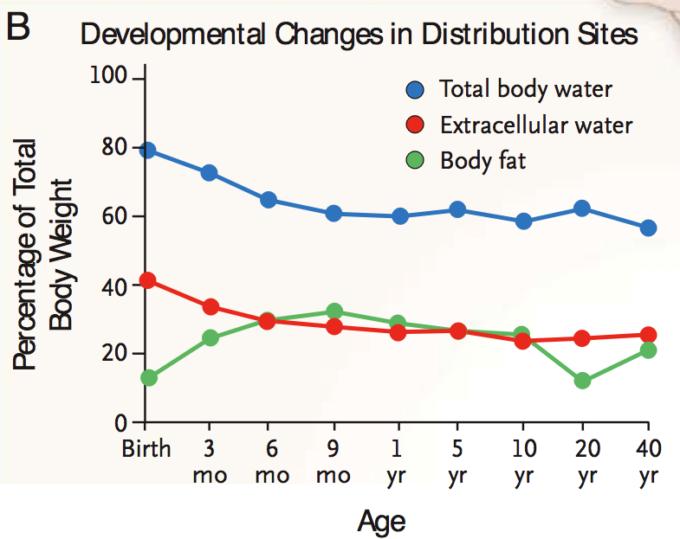

Slide 12
Pharmacokinetics in Neonates and Infants: METABOLISM
Hepatic metabolism
The drug-metabolizing capacity of newborns is low
Neonates are especially sensitive to drugs that are eliminated primarily by hepatic metabolism
The liver’s capacity to metabolize many drugs increases rapidly about 1 month after birth
The ability to metabolize drugs at the adult level is reached a few months later
Complete liver maturation occurs by 1 year of age
Notes:
12

Slide 13
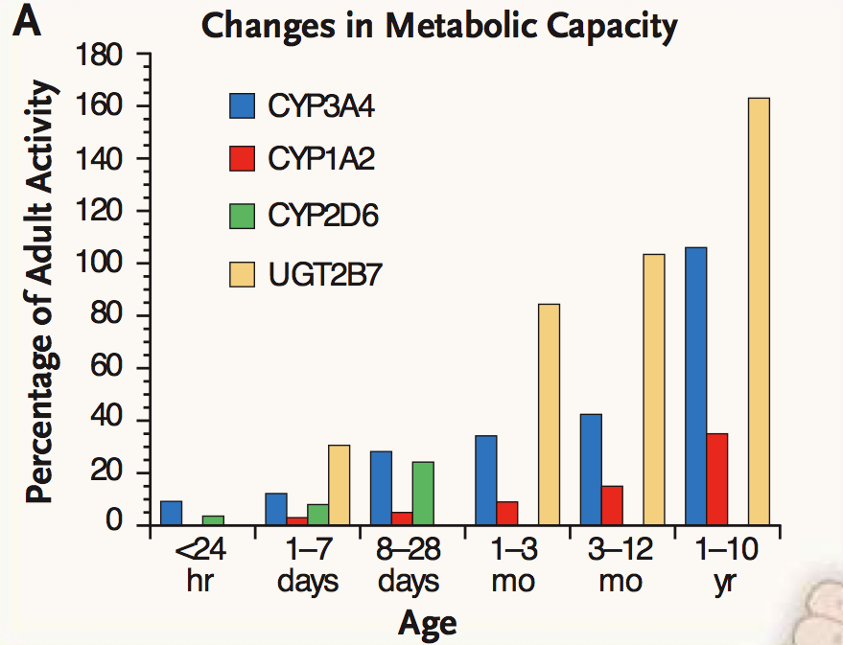

Slide 14
Pharmacokinetics in Neonates and Infants: EXCRETION
Renal excretion
Significantly reduced at birth
Low renal blood flow, low glomerular filtration, and low active tubular secretion
Drugs eliminated primarily by renal excretion must be given in reduced dosage and/or at longer dosing intervals
Adult levels of renal function achieved by 1 year
Notes:
14

Slide 15
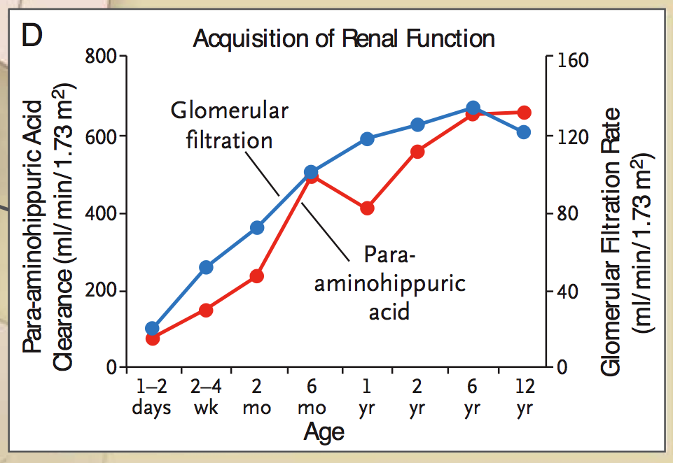

Slide 16
Drug Therapy in Pediatric Patients: Pharmacokinetics in Neonates and Infants
As a consequence of organ immaturity, newborns and babies in the first year of life have very different pharmacokinetics from adults
Fewer albumin proteins ⇒ greater concentrations of free drug
Elevated free drug levels ⇒ more intense response
Decreased hepatic metabolism ⇒ prolonged response
Decreased renal elimination ⇒ prolonged response
Blood-brain-barrier not well-formed ⇒ ↑CNS effects
Notes:
16

Slide 17
Drug Therapy in Pediatric Patients: Pharmacokinetics in Neonates and Infants
Babies under the age of one year are “more sensitive” to drugs
Immaturity of organs puts neonates & infants at risk for:
more intense, more prolonged responses
increased risk of adverse effects due to kinetics
Age-related unique adverse effects
Example: kernicterus
At the age of 1 year, most pharmacokinetic parameters in children are similar to those of adults
Notes:
17

Slide 18
Drug Therapy in Pediatric Patients: Pharmacokinetics in children aged one year and older
1
Children aged one year and older have pharmacokinetic parameters similar to adults, except one important difference: rate of hepatic metabolism varies
In children age 1 year and older, drug “sensitivity” is more like adults

Slide 19
Drug Therapy in Pediatric Patients Pharmacokinetics in children aged one year and older
From the age of 1 year until puberty, the rate of hepatic metabolism varies
Beginning ~ age 1 year, and until the baby reaches age 2 years, metabolism is markedly faster than adults
Then a gradual decline begins in the rate of hepatic metabolism
Then a sharp decline in the rate of hepatic metabolism occurs at puberty
May need to increase dosage or decrease interval between doses accordingly
Notes:
19

Slide 20
Drug Therapy in Pediatric Patients Pharmacokinetics in children aged one year and older
Various stages of ongoing growth and development also put children at risk for unique or age-related adverse effects
Examples :
Growth suppression (caused by glucocorticoids)
Discoloration of developing teeth (tetracyclines)
Kernicterus (sulfonamides)
Notes:
20

Slide 21
Safe dose approximation and the importance of careful monitoring
Drug Therapy in Pediatric Patients: Dose Approximation based on Body Surface Area

Slide 22
Drug Therapy in Pediatric Patients: Dose Approximation based on Body Surface Area
Pediatric dosing is commonly based on body surface area (BSA)
Approximate dosage for a child =
Body surface area of the child × adult dose
1.73 m²

Slide 23
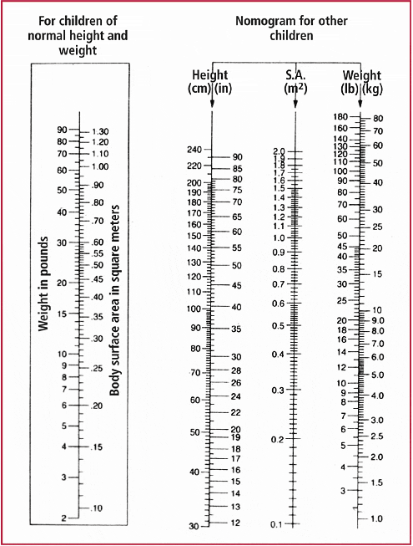
Example of a NOMOGRAM. Historically, nomograms were used to determine Body Surface Area. Calculations using a formula are more precise.

Slide 24
The surface area and the weight are the only common methods currently available to predict paediatric therapeutic doses from those used for adults.

Slide 25
Surface area
The surface-area or percentage method for estimating doses is calculated as follows:
(Surface area of child (m2)/1.76m2)*100
where 1.76 m2 is the average adult surface area.
Children are often said to tolerate or require larger doses of drugs than adults based on a weight basis, and the percentage method helps to explain this phenomenon.
Body water (total and extracellular) is known to equate better with surface area than body weight.
It thus seems appropriate to prescribe drugs by surface area if they are distributed through the extracellular fluid volume in particular.

Slide 26
Weight
Adult dose (mg)/70kg=mg/kg dose
where 70 kg is the average adult weight.
This method will give lower doses than the surface-area method.
It is far less accurate in clinical terms and is usually inappropriate for accurate therapeutic dosing.
However, as it gives lower and thus safer estimates of what the toxic dose may be, it is a more practical and reasonably cautious method for extrapolating toxic doses.

Slide 27
Reasons for Increased Risk
Different and changing pharmacokinetic parameters
Lack of pediatric formulations, dosage forms, guidelines
Calculation errors
Inconsistent measurement of preparations
Problems with drug delivery systems

Slide 28
Drug Therapy in Pediatric Patients: Promoting Adherence to a Medication Regimen
Effective two-way communication
Individualized patient education
Provide patient education in several ways
always in writing in addition to verbal, infomercial, class, etc
Demonstration techniques should be included when/if appropriate
“Teach Back”

Slide 29
Lack of Pediatric Formulations
May lead to:
Crushing tablets
Opening capsules and adding to food or beverage
Utilizing IV formulations for oral use
Using ophthalmic preparations in the ear
Giving oral anticonvulsants rectally
Compounding extemporaneous products

Slide 30
Barriers to commercial availability
Complications of testing in pediatric patients
Concerns involving informed consent
Recruitment problems (e.g., too few patients)
Determining which pediatric subset to test
Market limitations
Cost of testing may outweigh expected market
Market share typically less than in adult market
Less financial incentive to manufacturers for most disease states
Notes:
30
Often times, people will turn to investigational studies when they have no other options for treating a disease state.

Slide 31
Criteria for Using a Drug in a Child or Infant
Has there been documented efficacy for the medication for the disorder in newborn or older infants/children.
Is the data from adequate clinical trials (randomized, controlled, size, power, similar age/maturity)?
Has the safety been established for pediatric population?

Slide 32
Criteria for Using a Drug in a Child or Infant
Has the pathway of drug clearance been established in children/infants?
Is that pathway established in the child/infant you are treating (based on maturity or physical state)?
Is there reason to believe that pathway may be compromised in the specific child/infant (genetics, disease state, concomitant therapy)?
Have the pharmacokinetics been established in similarly aged children?

Slide 33
Criteria for Using a Drug in a Child or Infant
Is there a safe route to administer the drug? (intact GI tract, central access, intact skin, nontoxic solvent)
Is displacement an issue for albumin binding or bilirubin displacement?
Are there technical issues surrounding administration, e.g. solvents, preservatives, volume?
Is there an established dose and interval appropriate for age and disease state of the child?
Have a plan for monitoring for appropriate response to the agent.
Look for adverse effects of the agent.

Slide 34
Criteria for Using a Drug in a Child or Infant
The very small doses required in the most immature patients and the immature clearance pathways leave very little margin of error.

Slide 35
Drug Therapy in Pediatric Patients: Promoting Adherence to a Medication Regimen
Patient/ caregiver/ family need to know:
Name of medication
Purpose of medication
Dosage size and timing (r/t meals, other meds, time of day, symptom onset, and so forth)
Administration route and technique
Special considerations
Treatment duration
Drug storage- safety for children in household
Nature and time course of desired responses
Nature and time course of adverse effects: teach possible adverse effects, how to respond, when and how to follow-up with provider, and when to consult physician

